Slide 1
IR(Infrared Radiation)

Slide 2
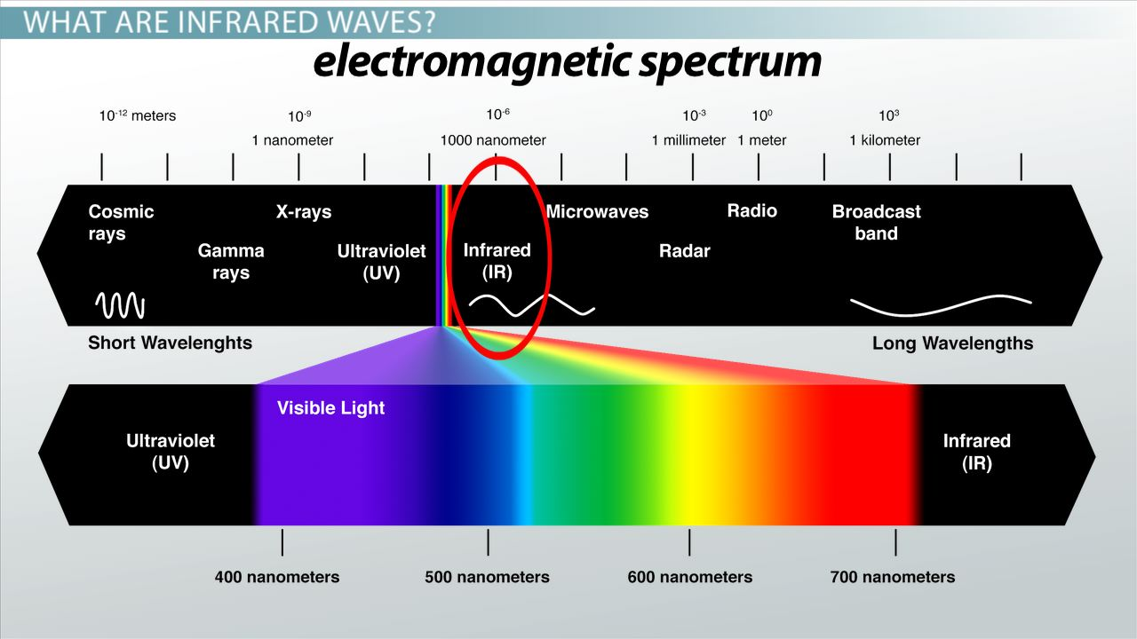
What we learned from Physics
A type of electromagnetic radiation
Wavelength: 700 nanometers (nm) to 1 millimeter (mm)
Frequency: between 300 GHz and 430 THz
Amplitude varies by source, distance, and emitting body

Slide 3
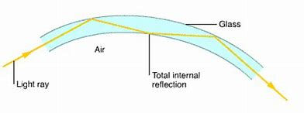

Usage of IR
Communication:
optical fibers
Remote control
Control and Monitor:
Controlling devices
Security systems

Slide 4
Objective
To construct a simple infrared transmission device
Where you press a button, a word appears in the Serial monitor

Slide 5
Equipment
The IR library is already in the We-chat group
-add through “sketch” in the software interface
IR remote
Arduino board
Expansion shield(拓展版)
-more pins to plug in
USB lines

Slide 6
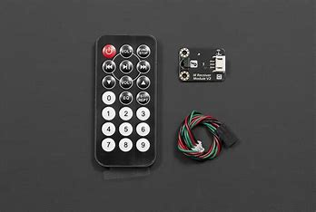
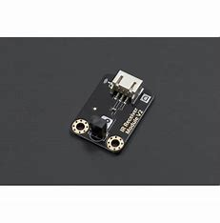
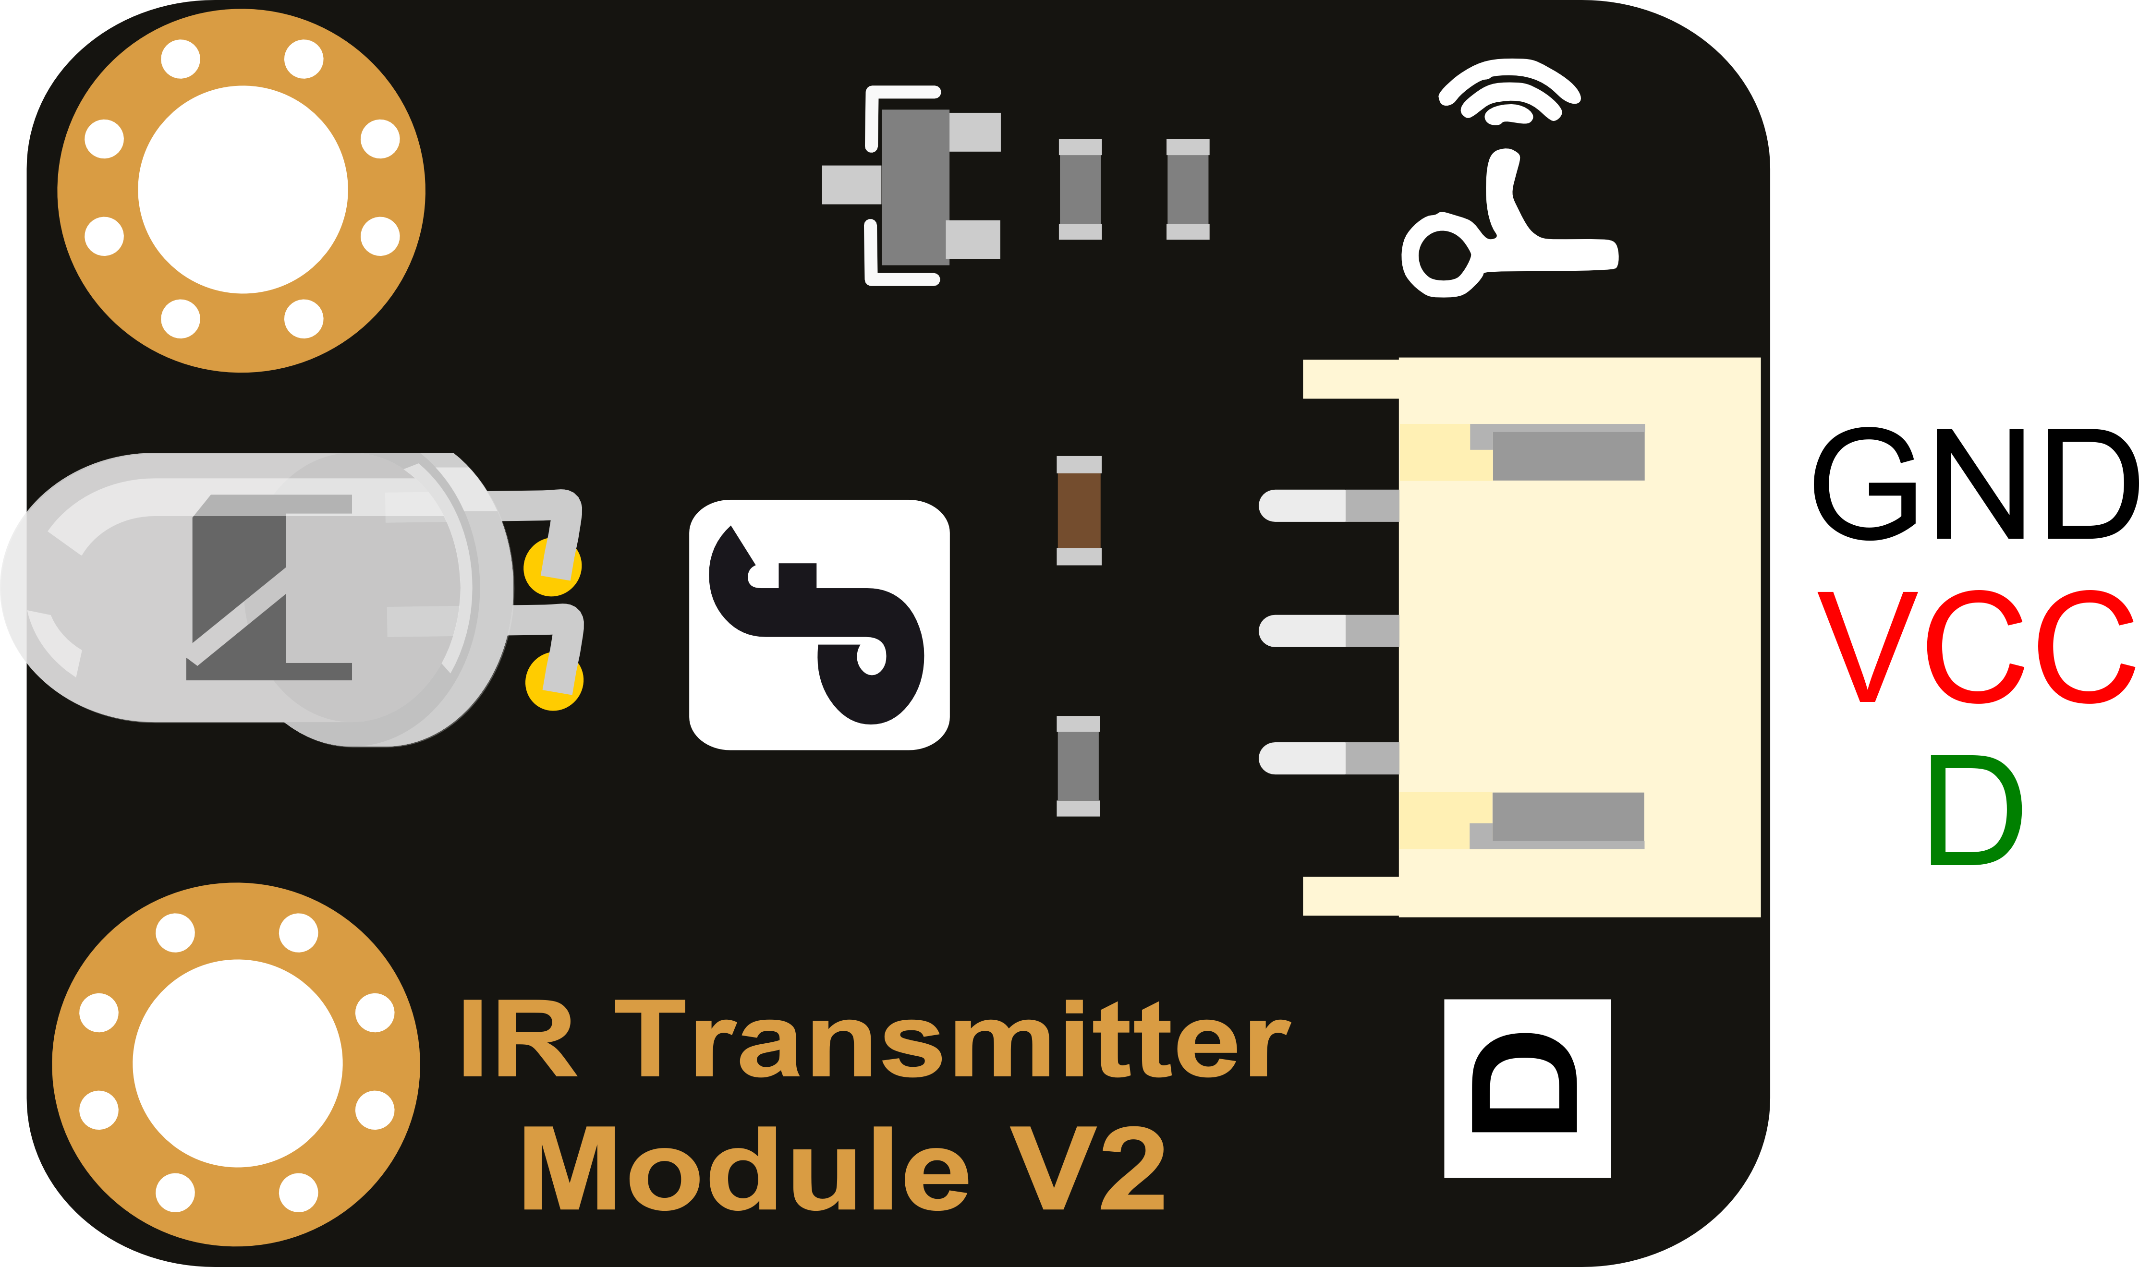
Gravity IR kit
Requires decoder, a piece of code
that interprets the signals received
-the board is able to receive command
from any remoter controller
if you have the right decoder
-Modulate Frequency: 38Khz

Slide 7
The code explained……
Setup portion:

Slide 8
Continued……
Loop portion

